Slide 1
JavaScript code smell detection
Presented by
Tulshi Chandra Das

Slide 2
Outline
Existing projects
Detected smells

Slide 3
Existing projects
JSNose
Github: https://github.com/saltlab/JSNose

Slide 4
Existing projects
Detected smells
Closure smells
Coupling of JS/HTML/CSS
Empty catch
Excessive global variables
Large object
Large object
Long message chain
Long method/function
Long parameter list
Nested callback
Refused bequest
Switch statement
Unused code

Slide 5
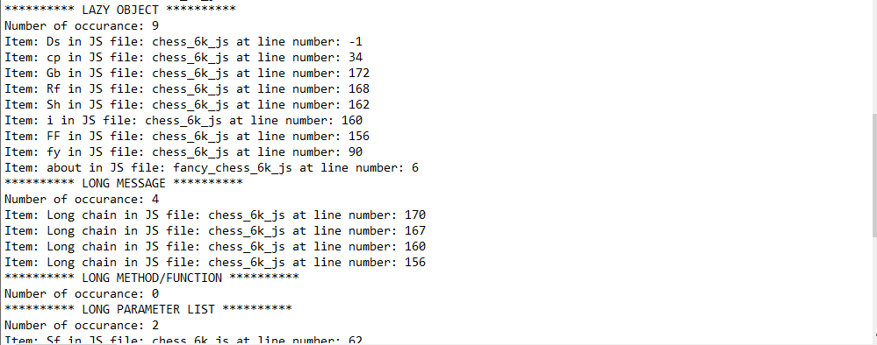
Existing projects(cont.)
Output

Slide 6
Existing projects(cont.)
Lackings
Not covered all smells
No development support

Slide 7
Existing projects(cont.)
Missing smell detection
Duplicate code
Large Class
Lazy Class
Feature envy
Comment

